Slide 1

Chapter 2
Understanding Economics and How It Affects Business

Slide 2



Slide 3
Learning Objectives
LO 2-1 Explain basic economics.
LO 2-2 Explain what capitalism is and how free markets work.
LO 2-3 Compare socialism and communism.
LO 2-4 Analyze the trend toward mixed economies.

Slide 4
How Economic Conditions Affect Businesses 1 of 7
What Is Economics?
Economics — The study of how society chooses to employ resources to produce goods and services and distribute them for consumption among various competing groups and individuals.
Macroeconomics — The part of economics study that looks at the operation of a nation’s economy as a whole.
Microeconomics — The part of economics study that looks at the behavior of people and organizations in particular markets.
LO 2-1
Notes:
See Learning Objective 1: Explain basic economics.
This slide gives students insight into the definition of economics. When going over this definition it often helps to further define the term resources. The term resources ties back into Chapter 1 and includes the factors of production: land, labor, capital, knowledge, and entrepreneurship.

Slide 5
How Economic Conditions Affect Businesses 2 of 7
What Is Economics? continued
Resource development — The study of how to increase resources and to create conditions that will make better use of those resources.
Examples of ways to increase resources
New energy sources
New ways of growing foods
New ways of creating goods and services
LO 2-1
Notes:
See Learning Objective 1: Explain basic economics.
Businesses can contribute to an economic system by inventing new products that increase the availability and development of an economy’s resources.

Slide 6
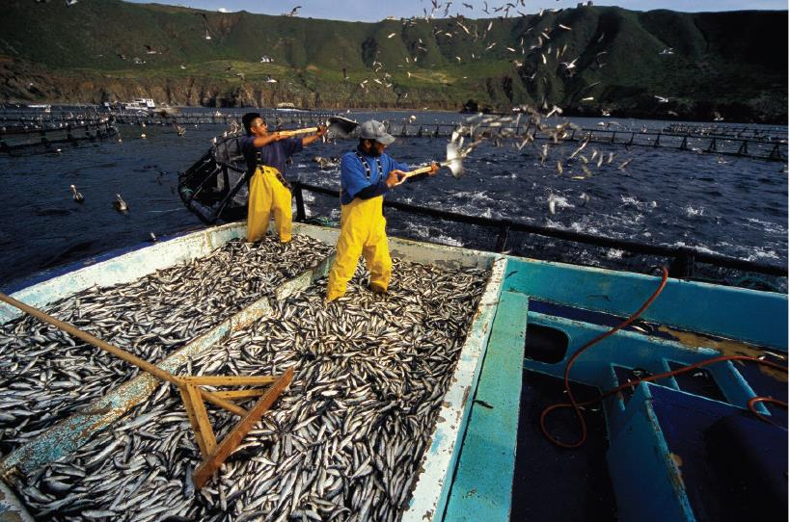
Production and the Economy
New ways of producing goods and services add resources to the economy and create more employment. Fish farms, for instance, create both food and jobs.
LO 2-1
©Mark Conlin/Getty Images
Notes:
See Learning Objective 1: Explain basic economics.

Slide 7
How Economic Conditions Affect Businesses 4 of 7
The Secret to Creating a Wealthy Economy
Population as a resource
Some macroeconomists believe a large population can be a resource.
An educated population is highly valuable.
Business owners provide jobs and economic growth for their employees and communities as well as for themselves.
LO 2-1
Notes:
See Learning Objective 1: Explain basic economics.
Malthus viewed a large population as a negative. However, many economists today see a highly educated population as a valuable, scarce resource. Countries like Japan and Germany are examples of nations that have become economically successful due to large well-educated populations producing sophisticated high-value products.

Slide 8
Understanding Free-Market Capitalism 1 of 9
Capitalism — An economic system in which all or most of the factors of production and distribution are privately owned and operated for profit.
Countries with capitalist systems:
United States
England
Australia
Canada
LO 2-2
Notes:
See Learning Objective 2: Explain what capitalism is and how free markets work.

Slide 9
Understanding Free-Market Capitalism 2 of 9
State capitalism — A combination of freer markets and some government control.
China has experienced rapid growth using state capitalism.
Goal: Three world leading tech companies by 2025
Investing $1.4 trillion
Housing projects, smart cities, and implementation of AI
Source: https://www.japantimes.co.jp/news/2020/05/21/business/china-plan-tech-crown/
Notes:
See Learning Objective 2: Explain what capitalism is and how free markets work.

Slide 10
Understanding Free-Market Capitalism 3 of 9
Capitalism’s Four Basic Rights
The right to own private property
The right to own a business and keep all that business’s profits
The right to freedom of competition
The right to freedom of choice
LO 2-2
Notes:
See Learning Objective 2: Explain what capitalism is and how free markets work.
The four basic rights under a capitalist system are straightforward, but which of the four basic rights has been weakened in the United States over the past 30 years? When asked this question, rarely do students touch on the concept of eminent domain and the weakening of the right to own private property due to the Kelo vs. New London Supreme Court case of 2005. If time permits, students can explore this case and the potential impact the case may have on American capitalism.

Slide 11
Understanding Free-Market Capitalism 4 of 9
Roosevelt’s (FDR’s) Four Additional Freedoms
Freedom of speech and expression
Freedom to worship in your own way
Freedom from want
Freedom from fear
LO 2-2
Notes:
See Learning Objective 2: Explain what capitalism is and how free markets work.

Slide 12
Understanding Free-Market Capitalism 5 of 9
How Free Markets Work
Free market — Decisions about what and how much to produce are made by the market.
Consumers send signals about what they like and how they like it.
Price tells companies how much of a product they should produce.
If something is wanted but hard to get, the price will rise until more products are available.
LO 2-2
Notes:
See Learning Objective 2: Explain what capitalism is and how free markets work.

Slide 13
Understanding Free-Market Capitalism 6 of 9
How Prices Are Determined
A seller may want to sell shirts for $50, but only a few people may buy them at that price.
If the seller lowers the price, quantity demanded increases.
LO 2-2
Notes:
See Learning Objective 2: Explain what capitalism is and how free markets work.
Prices are determined by consumers negotiating with the sellers of goods and services.

Slide 14
Understanding Free-Market Capitalism 7 of 9
Supply — The quantity of products that manufacturers or owners are willing to sell at different prices at a specific time.
Demand — The quantity of products that people are willing to buy at different prices at a specific time.
Market price (equilibrium point) – The price determined by supply and demand.
LO 2-2
Notes:
See Learning Objective 2: Explain what capitalism is and how free markets work.

Slide 15
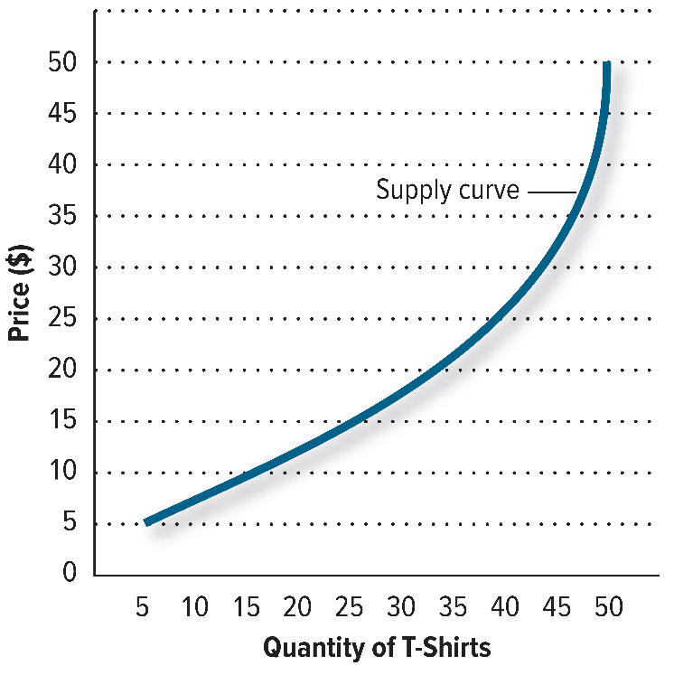
Figure 2.1 The Supply Curve at Various Prices
LO 2-2
Jump to long description in appendix
Notes:
See Learning Objective 2: Explain what capitalism is and how free markets work.
The supply curve rises from left to right. Think it through. The higher the price of T-shirts goes (the vertical axis), the more sellers will be willing to supply.

Slide 16
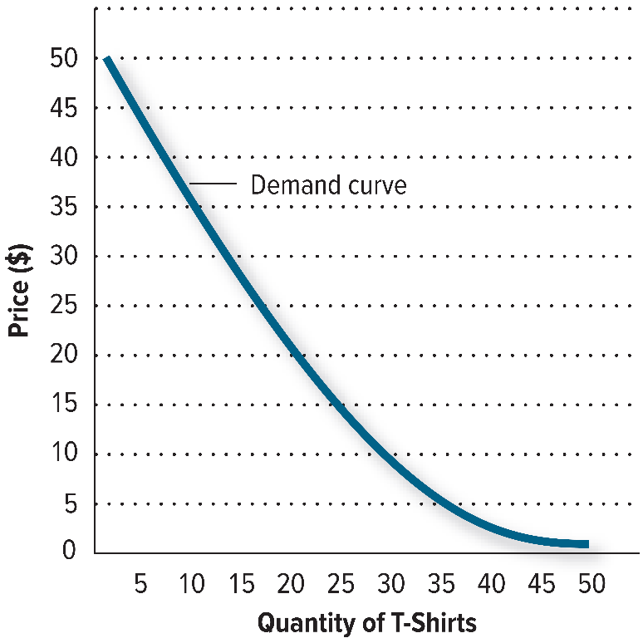
Figure 2.2 The Demand Curve at Various Prices
LO 2-2
Jump to long description in appendix
Notes:
See Learning Objective 2: Explain what capitalism is and how free markets work.
This is a simple demand curve showing the quantity of T-shirts demanded at different prices. The demand curve falls from left to right. It is easy to understand why. The lower the price of T-shirts, the higher the quantity demanded.

Slide 17
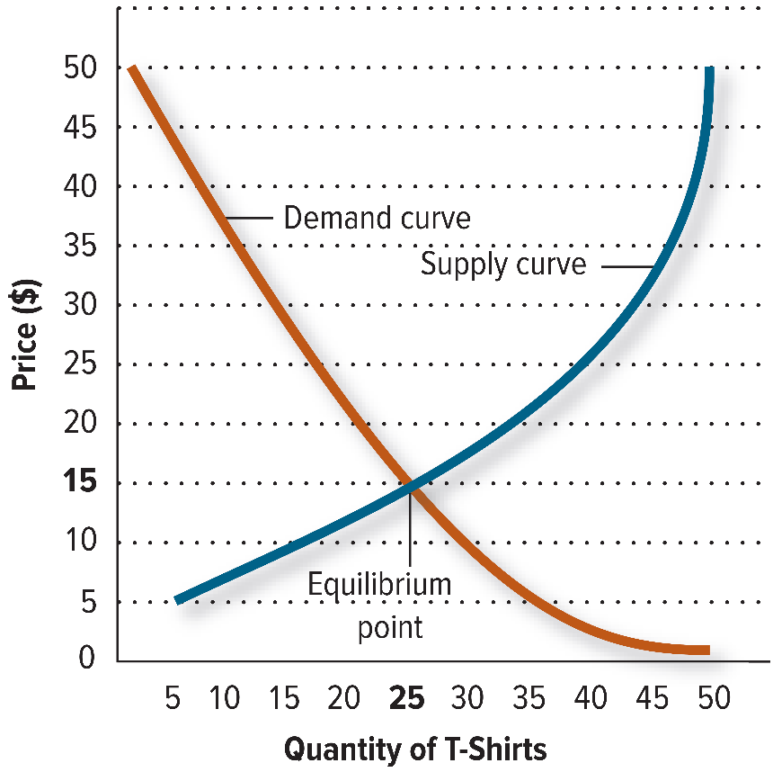
Figure 2.3 The Equilibrium Point
LO 2-2
Jump to long description in appendix
Notes:
See Learning Objective 2: Explain what capitalism is and how free markets work.
The place where quantity demanded and quantity supplied meet is called the equilibrium point. When we put both the supply and demand curves on the same graph, we find that they intersect at a price where the quantity supplied and the quantity demanded are equal. In the long run, the market price will tend toward the equilibrium point.

Slide 18
Understanding Free-Market Capitalism 9 of 9
Benefits and Limitations of Free Markets
Benefits:
It allows for open competition among companies.
It provides opportunities for poor people to work their way out of poverty.
Consumer freedom
Lack of bureaucracy
Limitations:
People may start to let greed drive them.
Poor quality
Unemployment and inequality
Source: https://www.intelligenteconomist.com/free-market/
Notes:
See Learning Objective 2: Explain what capitalism is and how free markets work.

Slide 19
Understanding Socialism 1 of 3
Socialism — An economic system based on the premise that some, if not most, basic businesses should be owned by the government so that profits can be more evenly distributed among the people.
Entrepreneurs run smaller businesses.
Citizens are highly taxed.
Government is more involved in protecting the environment and the poor.
The economic system should support people, whose basic nature is cooperative.
A success in Denmark vs. debt-plagued Greece
Source: https://www.thebalance.com/socialism-types-pros-cons-examples-3305592
Notes:
See Learning Objective 3: Compare socialism and communism.

Slide 20
Understanding Socialism 2 of 3
The Benefits of Socialism
Social equality
Free education
Free health care
Free child care
Longer vacations
Shorter work weeks
Generous sick leave
LO 2-3
Notes:
See Learning Objective 3: Compare socialism and communism.

Slide 21
Understanding Socialism 3 of 3
The Negative Consequences of Socialism
Few incentives for businesspeople to take risks means low social mobility.
Brain drain — The loss of the best and brightest people to other countries.
Fewer inventions and less innovation because the reward is not as great as in capitalistic countries.
LO 2-3
Notes:
See Learning Objective 3: Compare socialism and communism.

Slide 22
Understanding Communism
Communism — An economic and political system in which the government makes almost all economic decisions and owns almost all the major factors of production.
Prices don’t reflect demand, which may lead to shortages of items, including food and clothing.
Most communist countries today suffer severe economic depression.
LO 2-3
Notes:
See Learning Objective 3: Compare socialism and communism.

Slide 23
The Trend Toward Mixed Economies 1 of 3
Two Major Economic Systems
Free-market economies — Economic systems in which the market largely determines what goods and services get produced, who gets them, and how the economy grows.
Command economies — Economic systems in which the government largely decides what goods and services will be produced, who will get them, and how the economy will grow.
LO 2-4
Notes:
See Learning Objective 4: Analyze the trend toward mixed economies.

Slide 24
The Trend Toward Mixed Economies 2 of 3
Neither free-market nor command economies have created sound economic conditions.
Communist governments are disappearing.
Socialist governments are cutting back on social programs, lowering taxes, and moving toward capitalism.
Capitalist countries are increasing social programs and moving more toward socialism.
LO 2-4
Notes:
See Learning Objective 4: Analyze the trend toward mixed economies.

Slide 25
The Trend Toward Mixed Economies 3 of 3
Mixed economies — Economic systems in which some allocation of resources is made by the market and some by the government.
LO 2-4
Notes:
See Learning Objective 4: Analyze the trend toward mixed economies.

